Slide 1
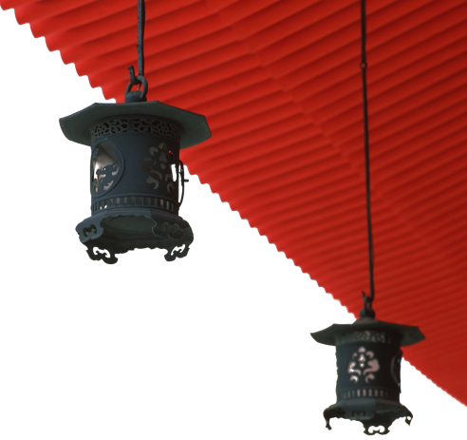

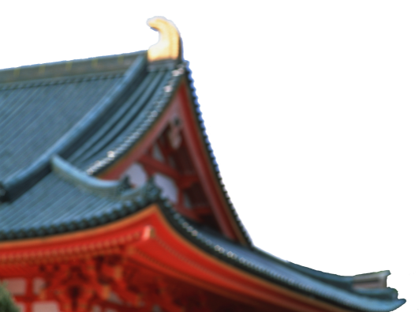
中国文化概况
A GLIMPSE OF CHINESE CULTURE

Slide 2
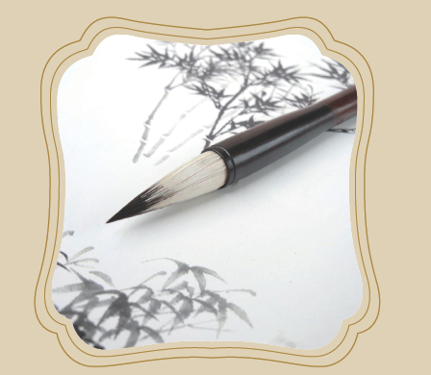
Chinese
Arts

Slide 3

学习目标
了解中国的艺术瑰宝
掌握有关艺术分类的基本词汇

Slide 4
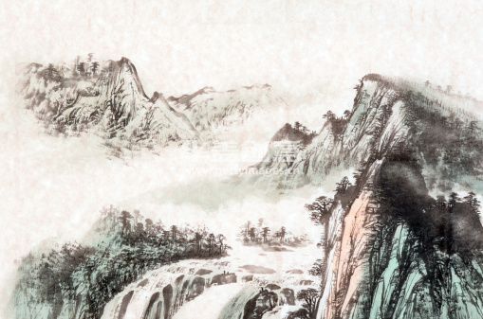
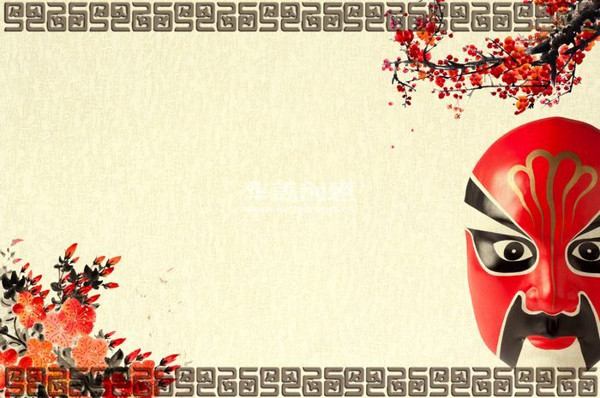
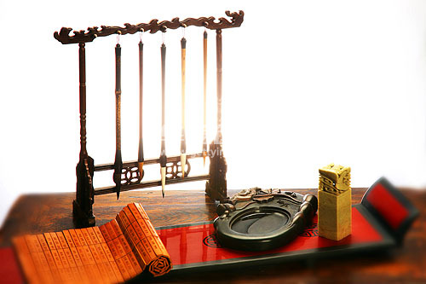
1
2
Overview
3
Lead-in Activity
Chinese Arts
Discussion &
Presentation

Slide 5
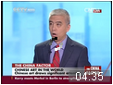

Lead-in Activity
Watch & Think
Watch the video clip and discuss:
Why do you think that Chinese traditional arts gain more
worldwide recognition and popularity?
With the changing times, a lot of traditional Chinese art forms
are facing a battle for survival. How do you think a balance can
be struck between preserving tradition and keeping up with the
times?

Slide 6
1
2
Overview
3
Lead-in Activity
Chinese Arts
Discussion &
Presentation

Slide 7
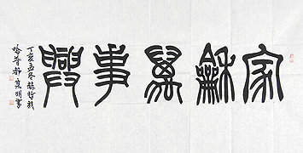
Calligraphy
The Seal Form (篆书)
with soft lines of strokes and upright
rectangular shape
close to pictography (象形文字)
has a balanced and symmetrical (对
称的) pattern.

Slide 8
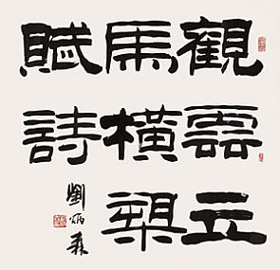
Calligraphy
The Official Form (隶书)
turning point in the evolution of
Chinese scripts
foundation of the later script forms
turned the remaining curved and
round strokes of the seal form into
linear (直线的) and flat square (扁方
形) shapes.

Slide 9
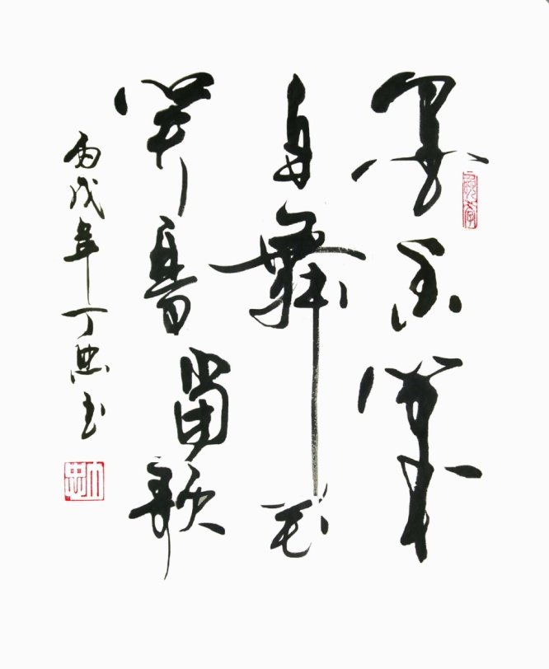
Calligraphy
The Cursive Form (草书)
smooth and lively with strokes
flowing and characters linking
together
often joined, with the last stroke of
one merging into the initial stroke of
the next.
executed freely and rapidly
appear exaggerated (夸张的)

Slide 10
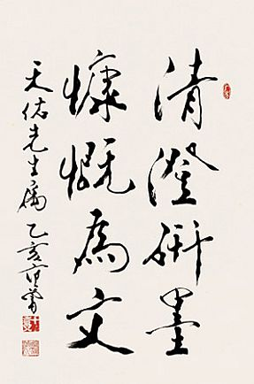
Calligraphy
The Running Form (行书)
somewhere between the regular and
the cursive forms
allows simpler and faster writing
can be classified into the running
regular form (行楷) and the running
cursive form (行草)

Slide 11
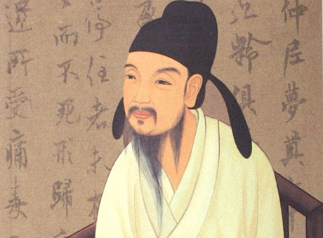
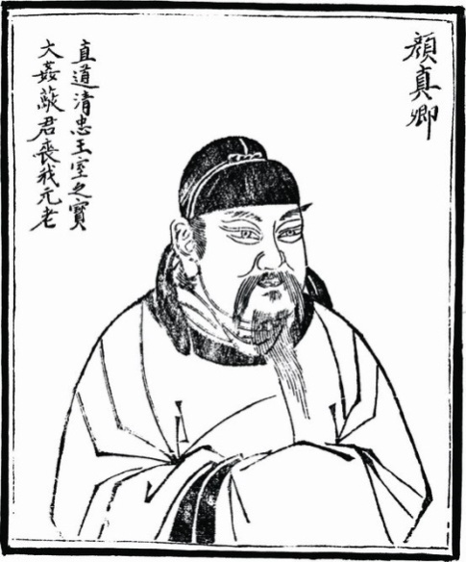
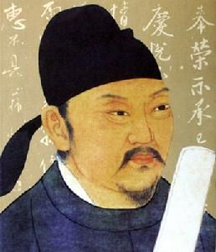
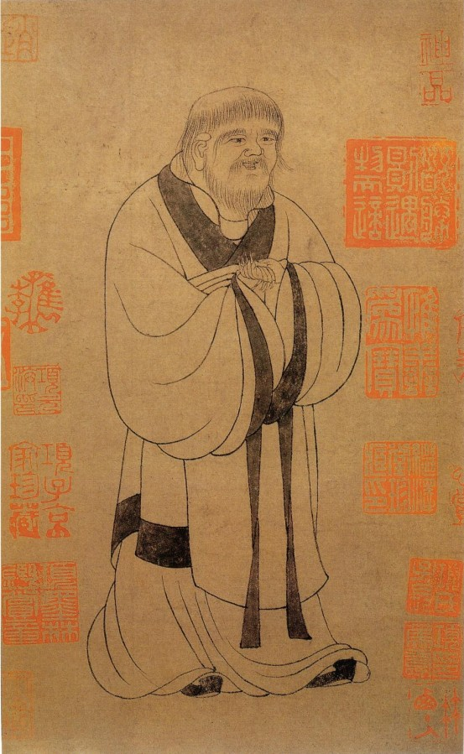
Calligraphy
Four Great Regular Script Masters
Ouyang Xun
Yan Zhenqing
Liu Gongquan
Zhao Mengfu

Slide 12
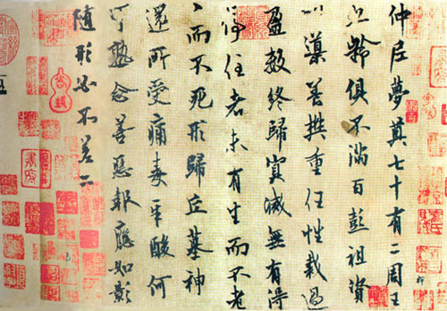
Calligraphy
let’s see the work of each master.
Ouyang Xun

Slide 13
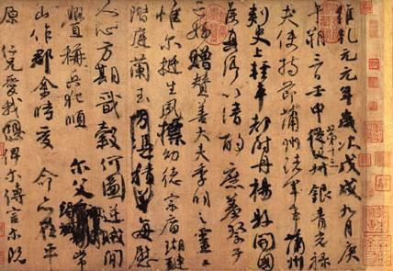
Calligraphy
Yan Zhenqing

Slide 14
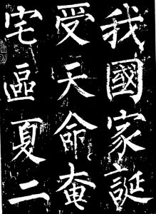
Calligraphy
Liu Gongquan

Slide 15
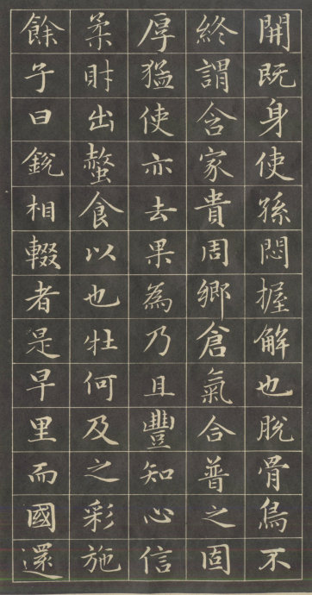
Calligraphy
Zhao Mengfu

Slide 16
Calligraphy and Painting
Calligraphy
Painting
Four Treasures of the Study

Slide 17
Painting
Outline
said to have the same origin as calligraphy
traditional Chinese painting --- ink-wash painting can be
traced back to the Tang dynasty
achieve an artistic unison by combining fine art, poetry,
calligraphy, and seal engraving

Slide 18
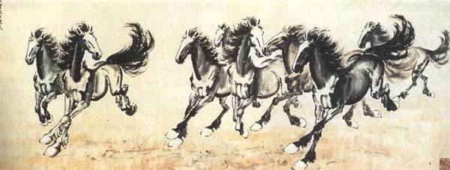
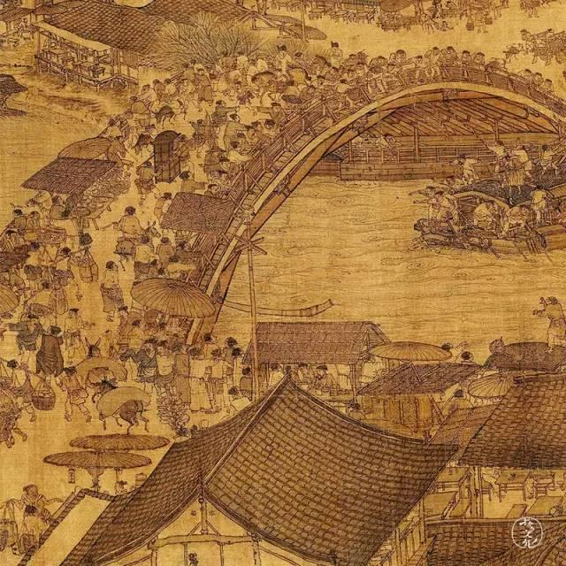
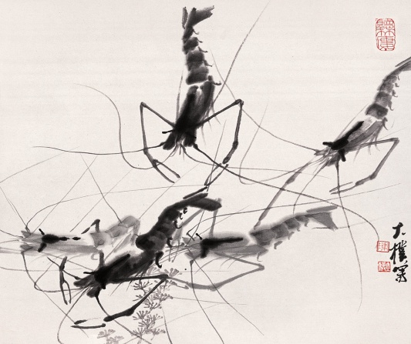
Painting
can you name the writers of the pictures?

Slide 19
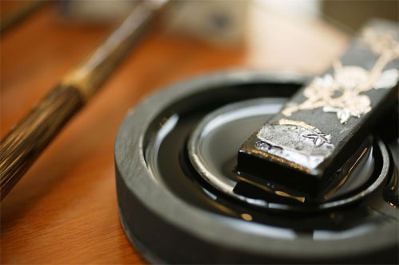
Four Treasures of the Study
Hui ink stick
produced in Huizhou, Anhui province
made from the ash of burnt green pine and mixed with glue
the writing will not easily fade

Slide 20
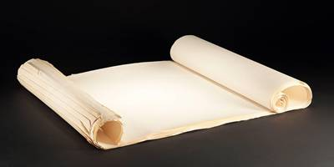
Four Treasures of the Study
Xuan paper
originally produced in Jing county under the jurisdiction of Xuanzhou
snow-white, durable, absorbent and moth-proof
principle type of paper for traditional Chinese calligraphy and painting

Slide 21
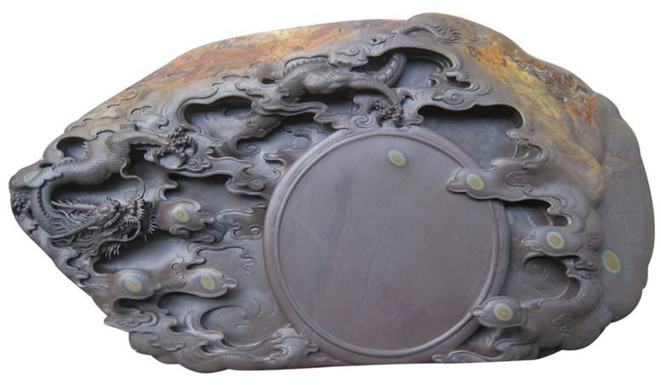
Four Treasures of the Study
Duan ink slab
first introduced in Duanzhou, Guangdong
fine, solid and glossy
ink prepared in it doesn’t dry
in various shapes and designs, also served as fine desk ornaments

Slide 22
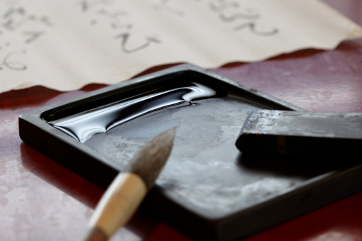
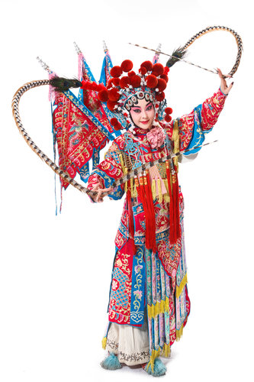
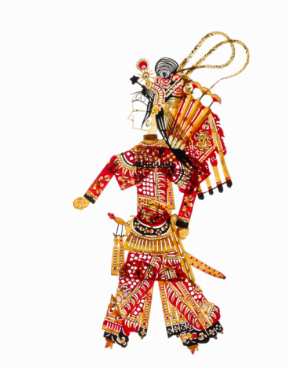
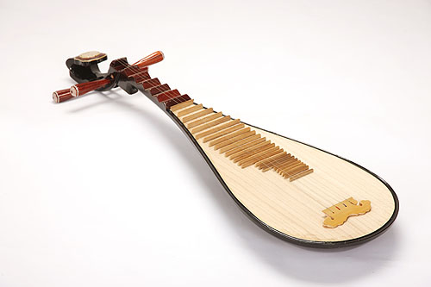
Chinese Arts
1
2
Calligraphy and Painting
Traditional Operas
3
3
4
4
Folk Performing Arts
Traditional Musical Instruments

Slide 23
Traditional Operas
Beijing Opera
Other Major Traditional Chinese Operas (Kungqu Opera, Henan Opera, Sichuan Opera, Shaoxing Opera, Huangmei Opera)

Slide 24
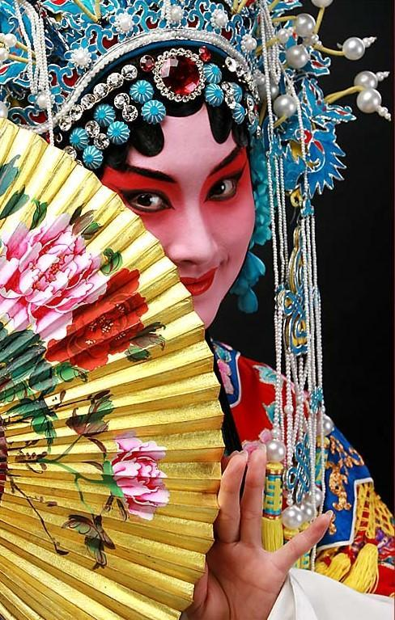
Beijing Opera
Beijing Opera
originally a form of local theatre,
then a national opera of China
the four basic skills include singing,
recitation, acting and acrobatic
fighting
the four major roles include sheng,
dan, jing and chou
has distinguished facial make-up and
costume

Slide 25
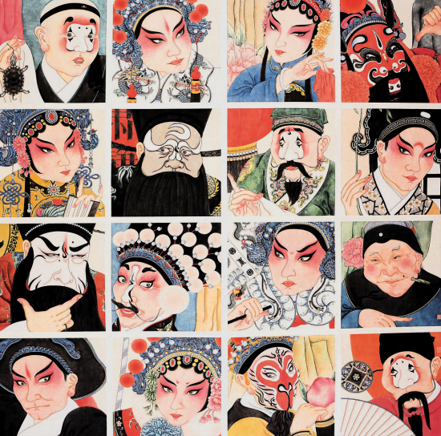
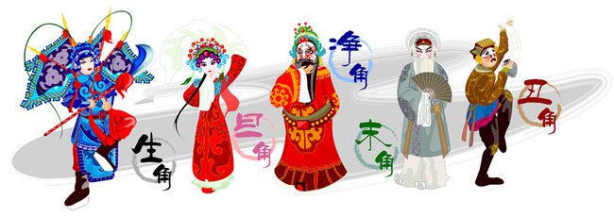
Beijing Opera
Sheng, Dan, Jing and Chou
the four roles include sheng (male),
dan (female), jing (male with a
painted face) and chou(clown)
classified according to sex, age,
disposition, profession, and social
status

Slide 26
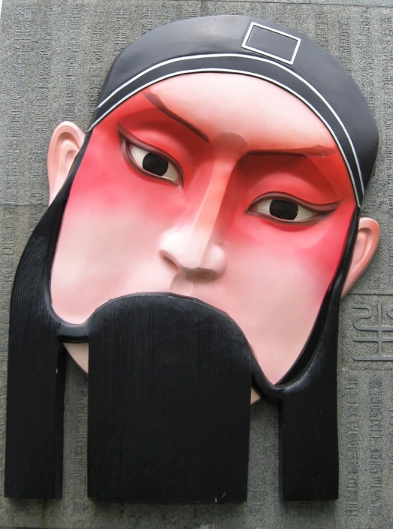
Beijing Opera
Sheng
generally positive
can be divided into laosheng (老生:
elderly men), wusheng (武生:
military men), xiaosheng (小生:
young men), and wawasheng (娃娃
生: children)

Slide 27
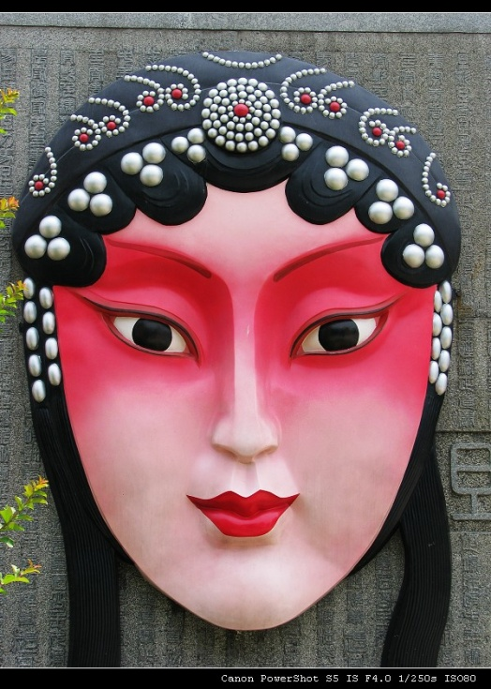
Beijing Opera
Dan
refers to various female roles
includes laodan (老旦), qingyi (青
衣), huadan(花旦), wudan(武旦)
and caidan (彩旦)

Slide 28
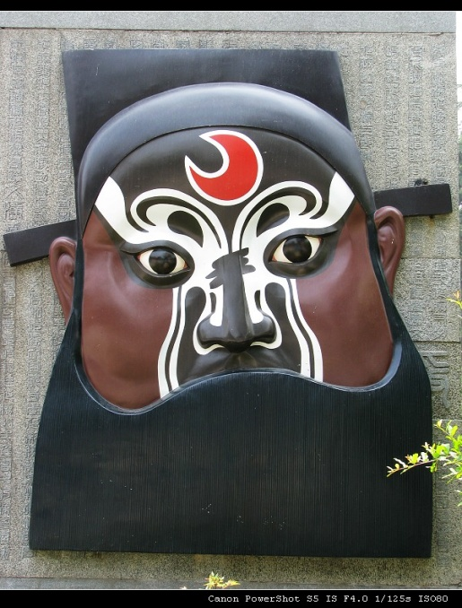
Beijing Opera
Jing
male with painted face
also known as hualian (花脸)
romantic and exaggerated role
classified into zhengjing (正净:
primary face-painted role), fujing (
副净: secondary face-painted role),
and wujing(武净: military face-
painted role)

Slide 29
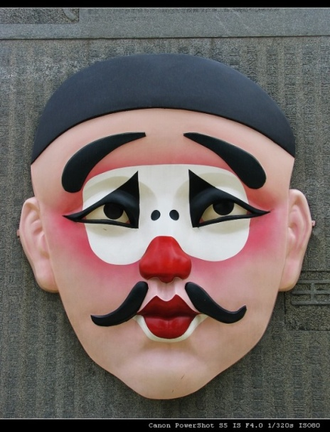
Beijing Opera
Chou
sharp-witted, clever, humorous,
honest and kind men
classified into wenchou(文丑:
comic civilian role) and wuchou (武
丑: acrobatic-fighting comic role)

Slide 30
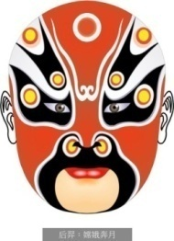
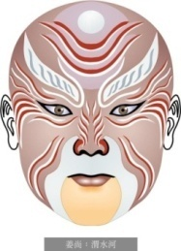
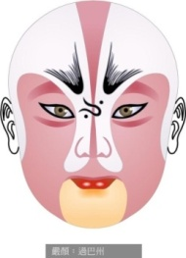
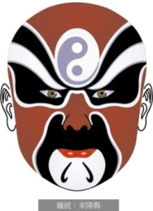
Beijing Opera
Facial Make-up and Costume in Beijing Opera
different types of make-up are consistent with the
characters they perform
to understand the color and the pattern and lines
drawn on the face are the two ways to distinguish a
character’s role or personality
different colors and forms of costume can be found
for different characters

Slide 31
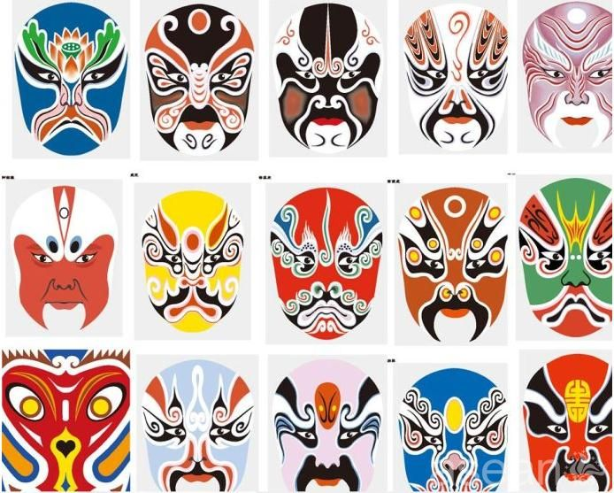
Beijing Opera
Can you tell the color code of painted faces?

Slide 32
Traditional Operas
Beijing Opera
Other Major Traditional Chinese Operas (Kungqu Opera, Henan Opera, Sichuan Opera, Shaoxing Opera, Huangmei Opera)

Slide 33
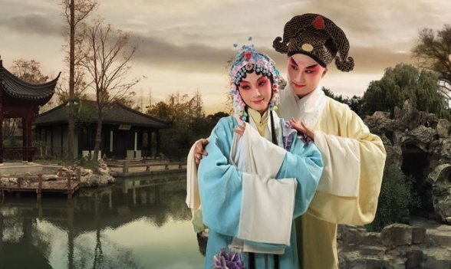
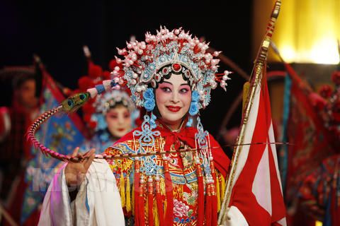
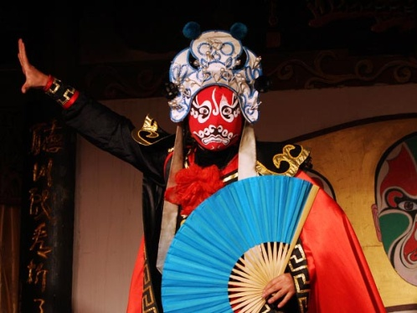
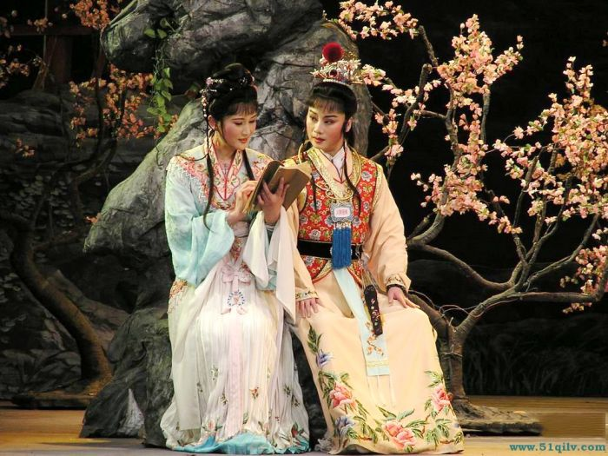
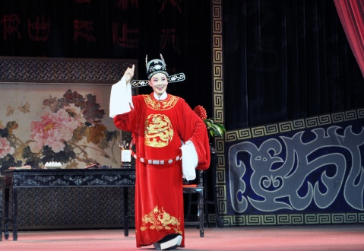
Other Major Traditional Chinese Operas
Kunqu Opera
Henan Opera
Sichuan Opera
Shaoxing Opera
Huangmei Opera

Slide 34
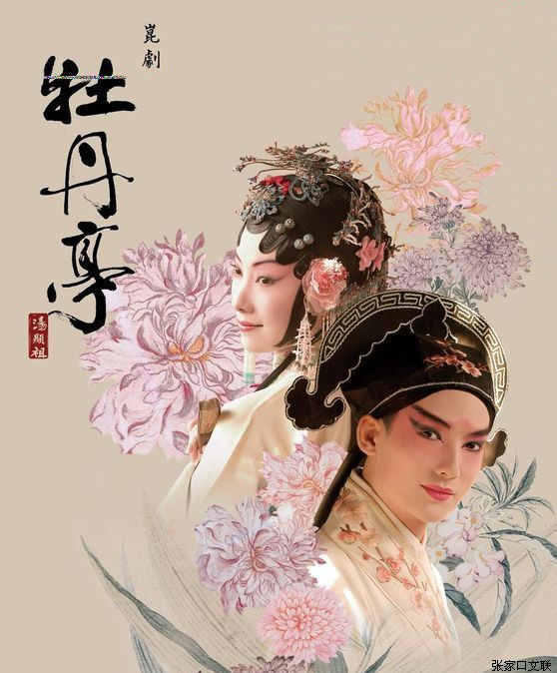
Other Major Traditional Chinese Operas
Kunqu Opera
one of the oldest operatic forms
considered the mother of many
other types of traditional opera
put on the list of the Oral and
Intangible Cultural Heritage by
UNESCO

Slide 35
Other Major Traditional Chinese Operas
Henan Opera
one of the most influential Chinese local
operas
also called Henan Bangzi
popular in the areas of the Yellow River
and Huai River
noted for demanding melodies, strong
rhythms and intensive use of spoken
language

Slide 36
Other Major Traditional Chinese Operas
Sichuan Opera
with a strong literary quality
full of wit, humour and lively dialogue
with a pronounced local flavour
with unique system of stylised
movement
famous for “face changes (变脸)”

Slide 37
Other Major Traditional Chinese Operas
Shaoxing Opera
originated in Shengxian county, Zhejiang
province
evokes sentimental emotions
with soft and gentle music and graceful
acting style

Slide 38
Other Major Traditional Chinese Operas
Huangmei Opera
local opera in Anhui province
easy to understand as it uses simple
words and literary traditions
mixed with northern and southern Anhui
dialects

Slide 39
Chinese Arts
1
2
Calligraphy and Painting
Traditional Operas
3
4
3
4
Folk Performing Arts
Traditional Musical Instruments

Slide 40
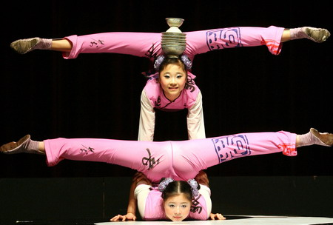
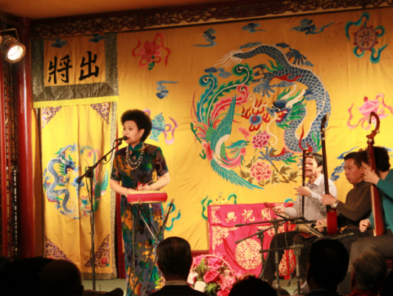
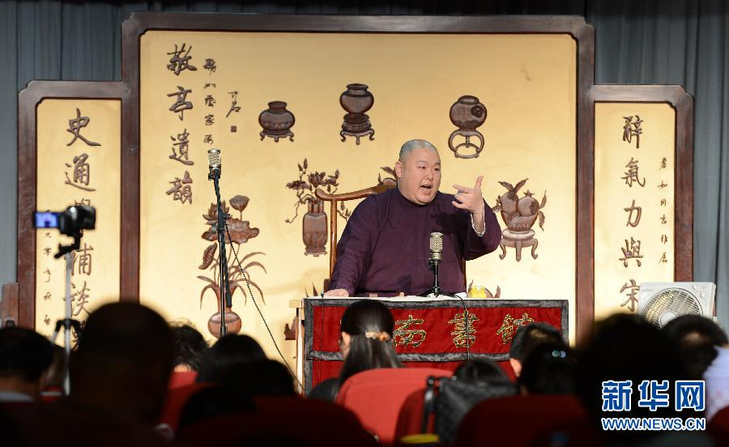


Folk Performing Arts
Can you name the following folk performing arts?

Slide 41
Folk Performing Arts
Acrobatics
has been in existence for over 2000
years
Chinese acrobatics enjoy fame around
the world and play a dominant role

Slide 42



Folk Performing Arts
Quyi
crosstalk
clapper talk
pingshu
short play

Slide 43
Quyi
Crosstalk
characterized by talking, imitation, fun-making, and singing
with satire as its main purpose
classified into three types: comic monologue, comic
dialogue, and group crosstalk

Slide 44
Quyi
Clapper talk
the comic rhymes or monologues are delivered with
the accompany of bamboo clappers

Slide 45
Quyi
Pingshu
the comic rhymes or monologues are delivered with
the accompany of bamboo clappers

Slide 46
Quyi
Short play
about 15 minutes in length
short, light comedies in the Huaju (spoken drama) style
popular on China’s Spring Festival Gala Show for
decades

Slide 47
Folk Performing Arts
Puppet Play
with a long history of over 2000 years
combines elements of singing,
dancing, painting, and sculpture
the puppets were moved by the
actors using sticks and strings
usually accompanied by tunes from
local operas

Slide 48
Folk Performing Arts
Shadow Play
the figures are reflected on a screen
by lantern light
the shadow puppets are valuable folk
handicrafts
collected by many museums and
enthusiasts

Slide 49
Chinese Arts
1
2
Calligraphy and Painting
Traditional Operas
3
3
4
Folk Performing Arts
Traditional Musical Instruments

Slide 50



Traditional Musical Instruments
Can you classify the following instruments?
wind instruments
percussion instruments
plucked instruments

Slide 51




Plucked Instruments
Can you match the instruments with the right descriptions?
A
B
C
D
an ancient plucked, four-string instrument made of wood. The player holds it vertically and plucks its four strings with five fingers. __________
an instrument with three-string stem attached to a wooden cylinder _____
known in the West as the “Chinese violin”. It is a two-string bowed musical instrument. ______
It has a special wooden sound body with strings arched across movable bridges along the length of the instrument. ______
B
D
C
A

Slide 52


Percussion Instruments
Drum
Gong
a hollow cylinder or
hemisphere
played by beating the
membrane with hands
or sticks
made of copper
in the shape of a disk
beaten with a wooden
hammer

Slide 53

Wind Instruments
ceremonial horn
bamboo flute
made of bamboo
with a row of holes, bamboo
membrane and a sound-
adjusting hole
played horizontally
the vertical bamboo flue is
called xiao
a woodwind instrument
mouthpiece made of brass,
body made of wood
produce resonant sounds
can be played in bands or as a
solo instrument

Slide 54
1
2
Overview
3
Lead-in Activity
Chinese Arts
Discussion &
Presentation

Slide 55

Discussion
It is commonly believed that many traditional Chinese art forms have lost its appeal among young people. Please conduct a survey on Chinese calligraphy on your campus to find out young people’s attitude towards it and the reason for their attitude. Then share the result with the class.

Slide 56
Students’ Presentation
You are attending a UNESCO conference, in which student deputies from universities across the world are invited to present their opinions on traditional art forms. As a Chinese student, you are expected to introduce one traditional art form in China.
Your introduction should cover the following points:
1 its history;
2 its present situation;
3 how people can promote its development and popularity.

Slide 57

Students’ Presentation
Inspirations for you!
Paper-cut
a very distinctive visual art of Chinese handicrafts
originates from the 6th century
now it has become a very popular means of decoration
among country folk, especially women
used on many occasions, such as Spring Festival,
wedding ceremony, birthday parties, etc.
some ways of developing the art form includes holding
cultural festivals, teaching children how to do paper-cut
and holding some lectures

Slide 58
The End

